Slide 1
M10

Slide 2
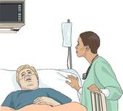
Principles of prevention
Prevention is better than cure for 3 main reasons
1. Sometimes body functions are so damaged that they do not recover completely.
2. The patient becomes bedridden for sometimes.
3. The infection may spread.

Slide 3

Principles of prevention
How can we prevent diseases?

Slide 4


Principles of prevention
There are two ways,
1. General way and
2. Specific way
The general ways of preventing infections :
1.
Airborne microbes
Prevent overcrowding

Slide 5
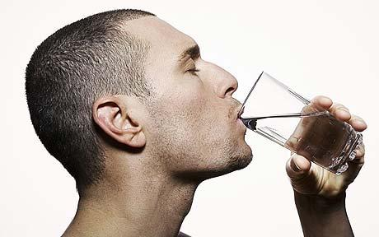
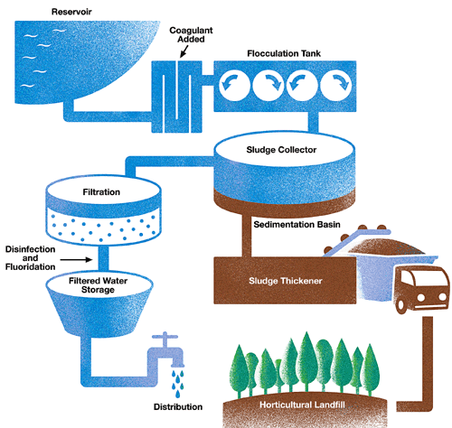
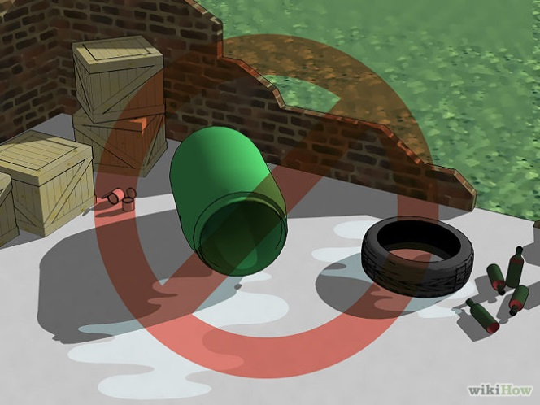
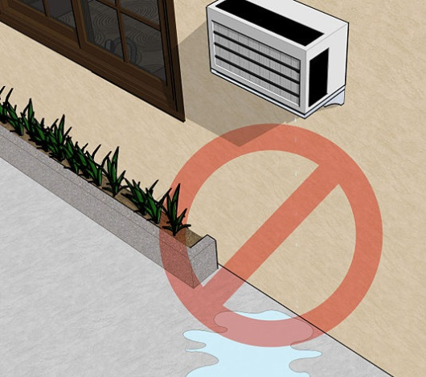
2.
Water borne microbes
Prevent exposure by providing safe drinking water.
This can be done by treating the water to kill any microbial contamination.
3.
Vector-borne infections
Provide clean environments.
E.g. – Do not allow mosquito breeding.

Slide 6

In addition to these issues that relate to the environment, there are some other general principles to prevent infectious diseases.
E.g. If someone is suffering from a cold and cough in the class, it is likely that the children sitting around will be exposed to the infection.
But all of them do not actually suffer from the disease.
Why Not ?

Slide 7
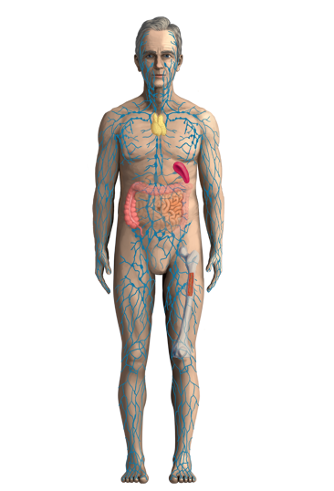






This is because the immune system of our body is normally fighting off microbes.
We have cells that specialise in killing infecting microbes.
These cells go into action each time infecting microbes enter the body.
If they are successful, we do not actually come down with any disease.
WBC
Foreign Particle

Slide 8
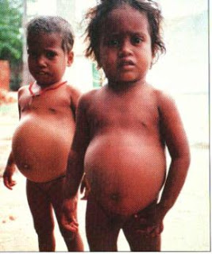
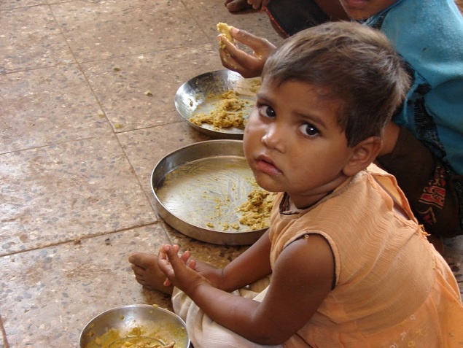

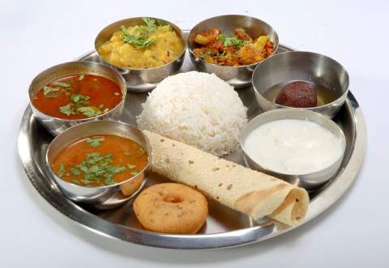
So, one way of looking at severe infectious diseases is that it represents a lack of success of the immune system.
The functioning of the immune system, like any other system in our body, will not be good if proper and sufficient nourishment and food is not available.
Therefore, the second basic principle of prevention of infectious disease is the availability of proper and sufficient food for everyone.

